Slide 1

Mid Semester Presentation Session: July- December 2021
S.p.a.c.e.r.
(swarm propelled Autonomous celestial exploratory ROBOTs)
Submitted to:
Inderpreet singh sIR
Submitted by:
Preetinder Singh (19BEM1032)
UIE-Department of Mechatronics Engineering

Slide 2
contents
INTRODUCTION
ABSTRACT
CONCEPT AND OUR VISION
COMPONENTS LIST
APPLICATIONS
WORK DISTRIBUTION
FUTURE SCOPE
Future objectives of the spacer versions
CONCLUSION

Slide 3


our Crew members
1) Preetinder singh -19BEM1032
2) Orsu vinay -20BEM8001
3) Ajay kumar – 19BEM1017
4) Pacha bhanuprasad -19BEM1011
5) Sankhadip Paul – 20BEM8005

Slide 4
Our VISION
Our team believes that robots should be used at the places where human capabilities are getting hampered ie. places which have:
High radiation content
Extreme temperatures
Difficult or risky for humans ( Skyscrapers for construction and repair)
Underwater exploration
Space exploration etc.
And because of which we are trying to create a new concept of robots which will expand the capabilities of hamanking by giving us the ability to maintain our curiosity without risking any life and
discover which is still yet to be discovered...

Slide 5
ABSTRACT:
Our project Swarm Propelled Autonomous Celestial Exploratory Robots (S.P.A.C.E.R.) is a swarm project in which each robot is having the special feature of defying gravity. It can move up the steep mountain and down the trench as well as underwater and overwater. It can do so with the help of a brushless motor. Because of its ability to climb steep slopes, it can access different layers of steep mountains and trenches and thus can acquire information from there. It can extract information about earth or any other planet. In this way, it can open new doors in the field of space research.
Keywords-swarm propelled; robot; defying gravity; brushless motor

Slide 6
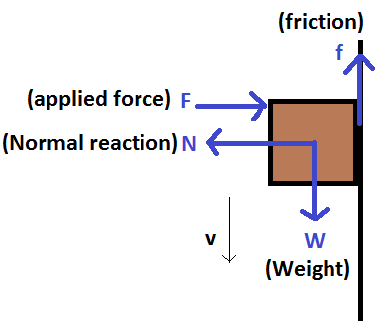
How wE DID that?
Answer lies in SCIENCE

Slide 7
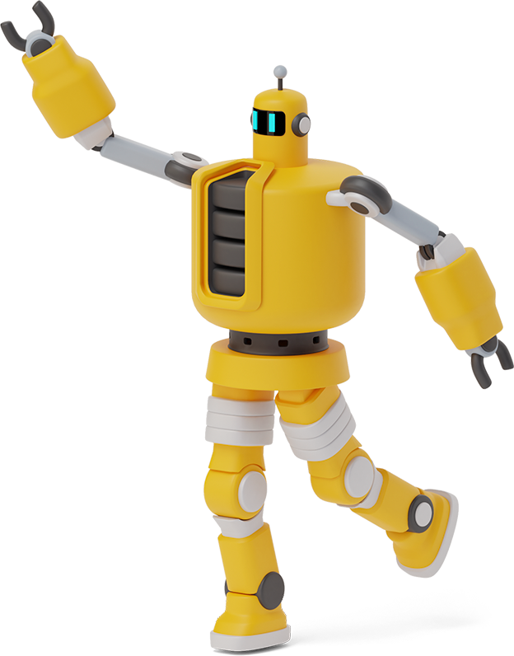
components required FOR our pROTOTYPE:
Arduino/ Teensy 3.6 board
nRF24L01 2.4gHz RF module
EDF WITH 2600KV BLDC MOTOR
7 inch Propeller
Bluetooth module
Sunboard for body structure
HOBBYWING 30A ESC
DC high torque motor 30 RPM
Power distribution module
Motor Driver (MOSFET based)
Li-ion Batteries
Ultra heavy grip tires

Slide 8
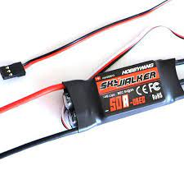
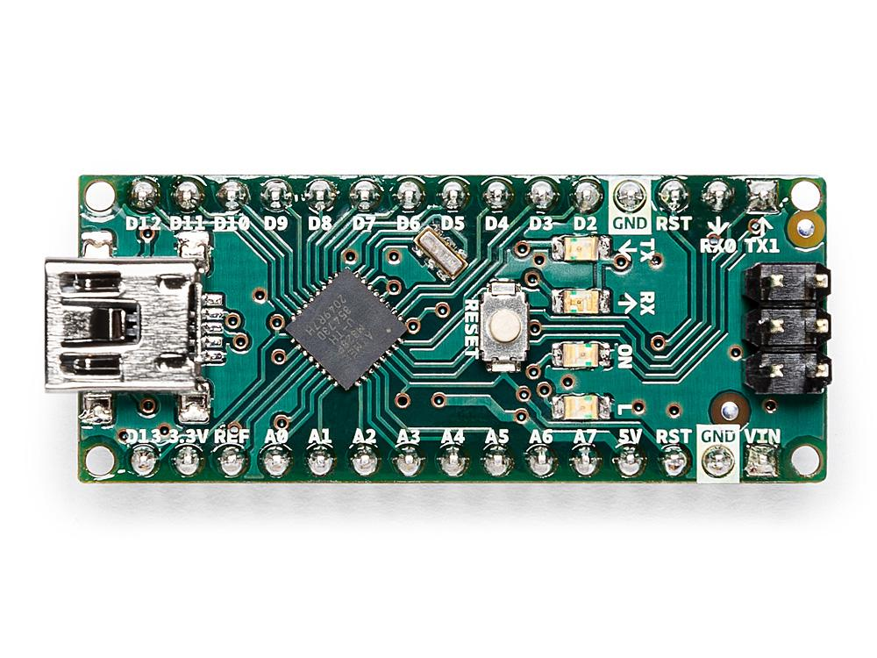
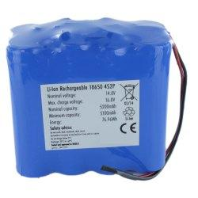
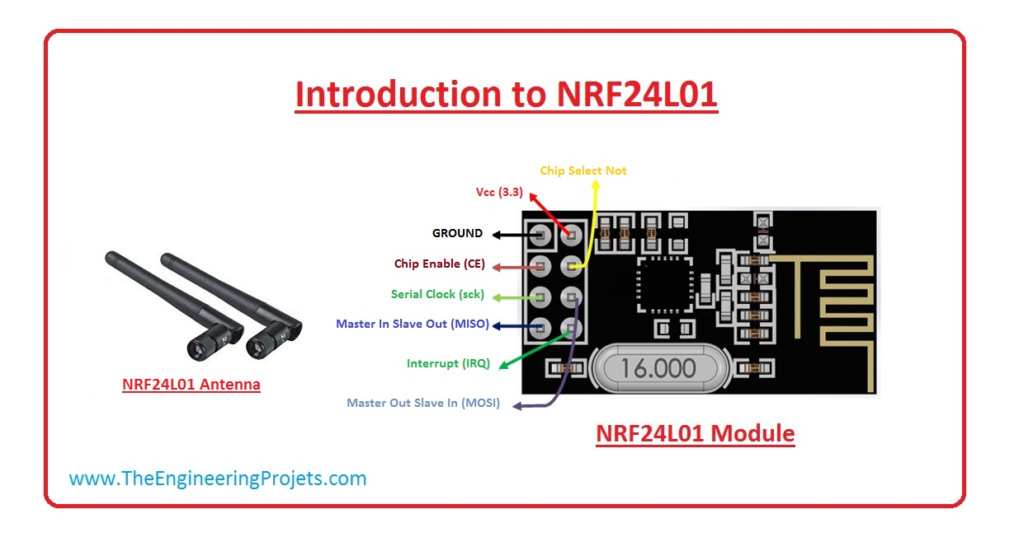
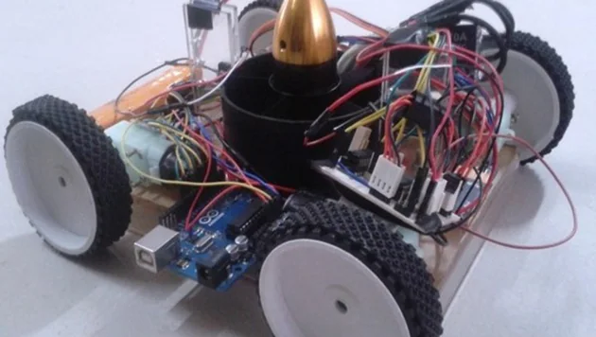
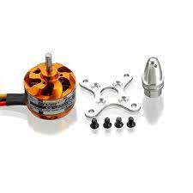
Hobbywing 30A ESC :
Arduino Nano
4S 2600MAH LI ion BATTERY
NRF24L01 A Similar type of design of with duct fan Brushless motor 2600kv

Slide 9
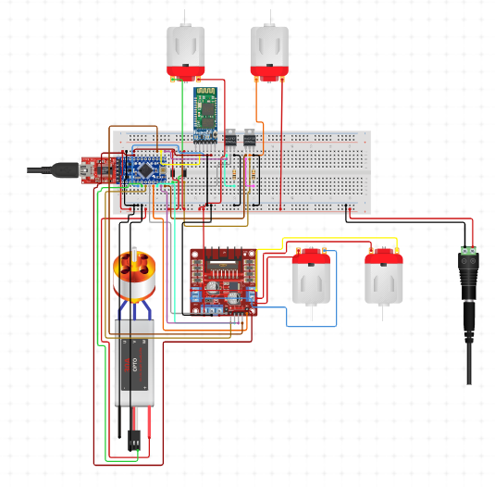
BLOCK DIAGRAM OF SPACER

Slide 10
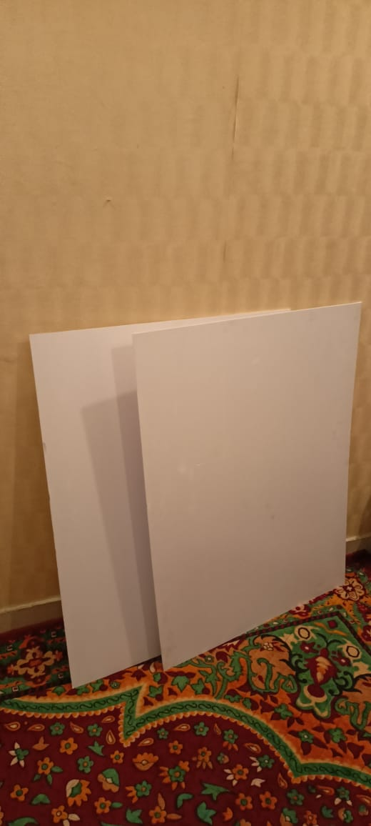
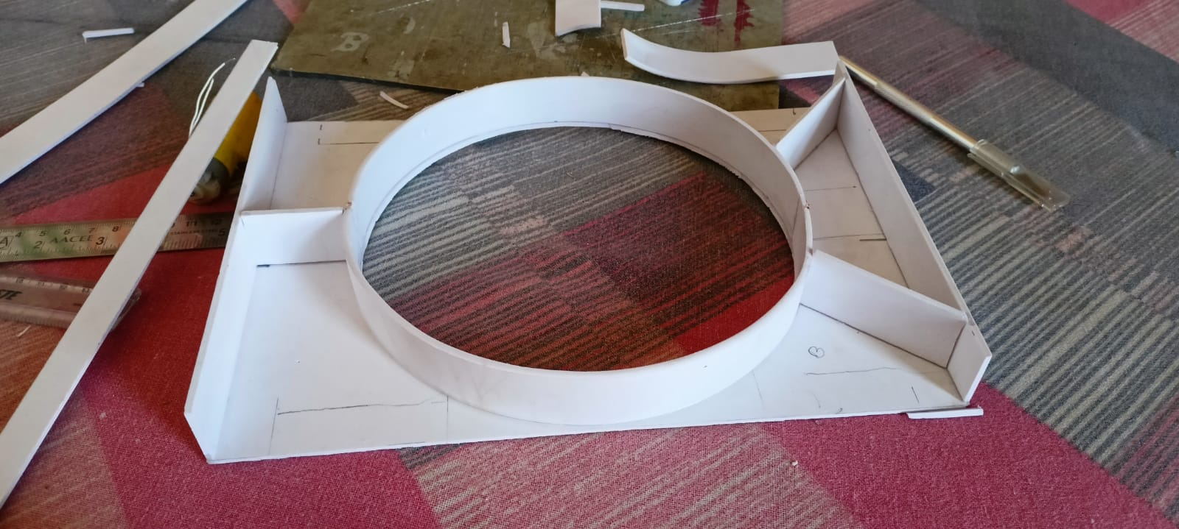
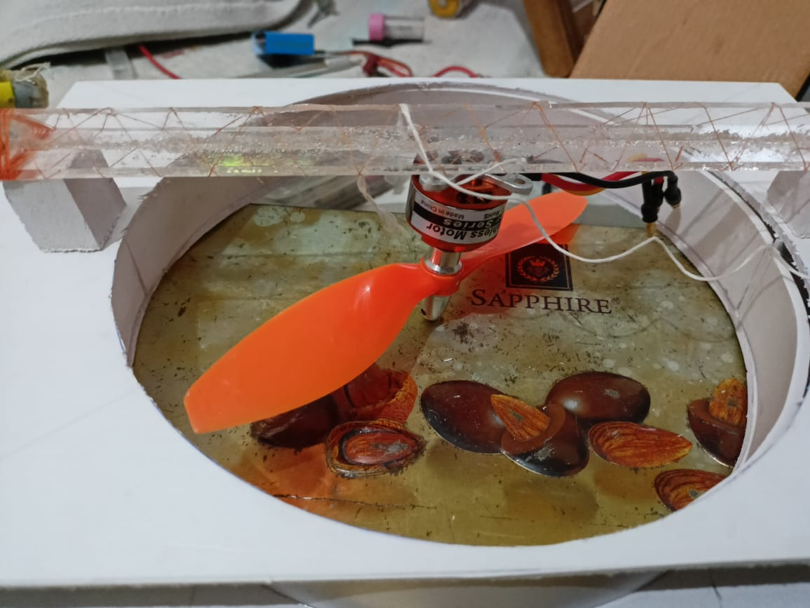
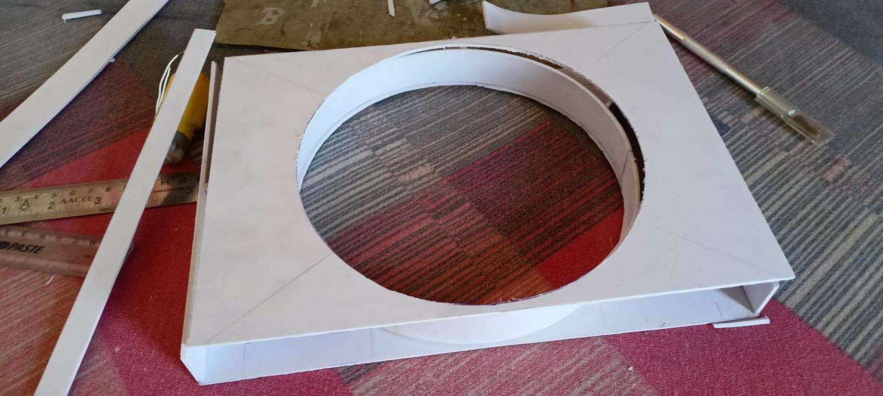
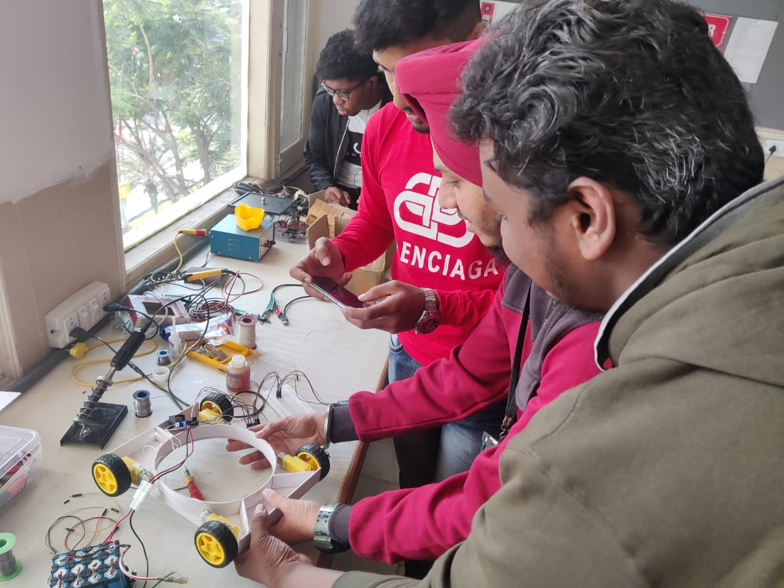
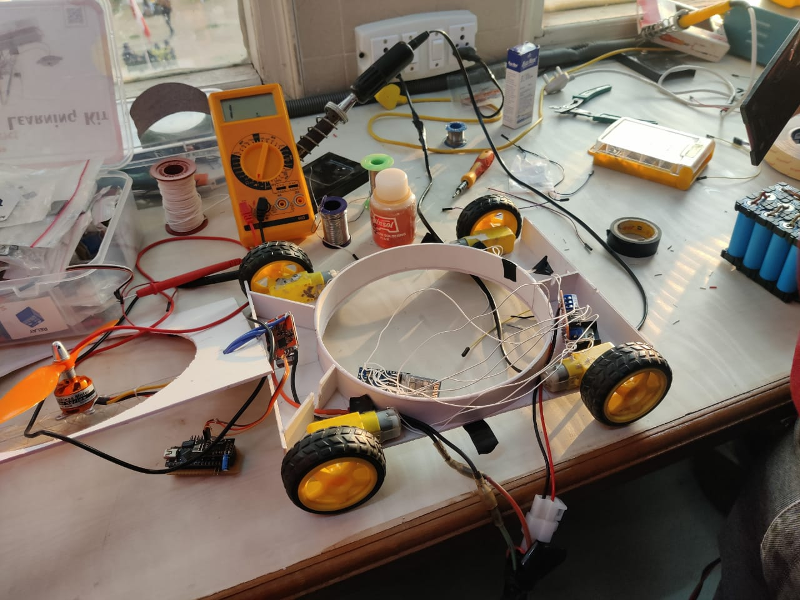
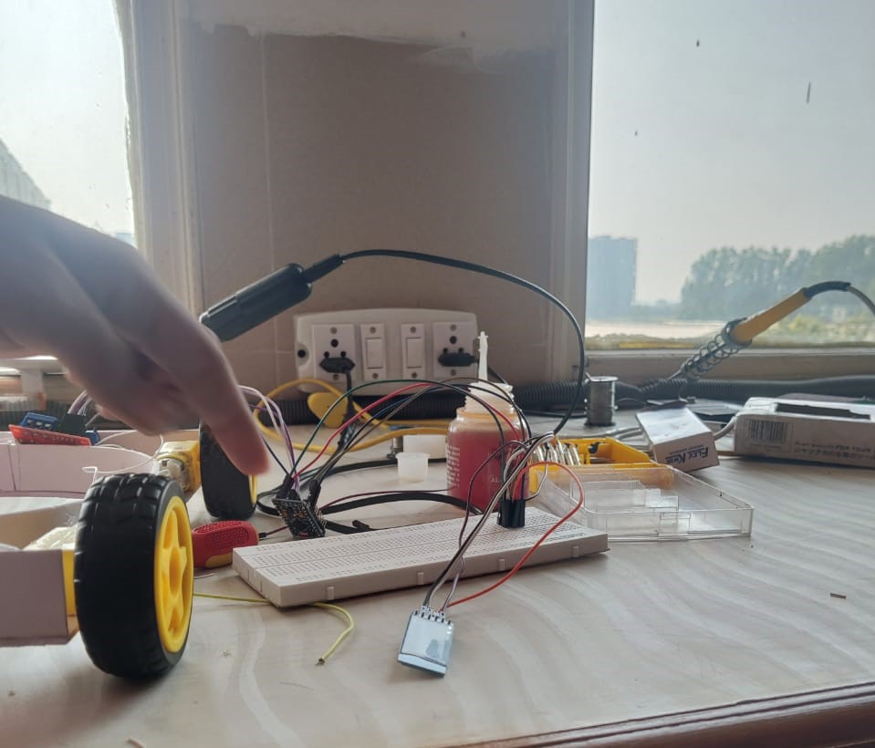
Robot making journey

Slide 11
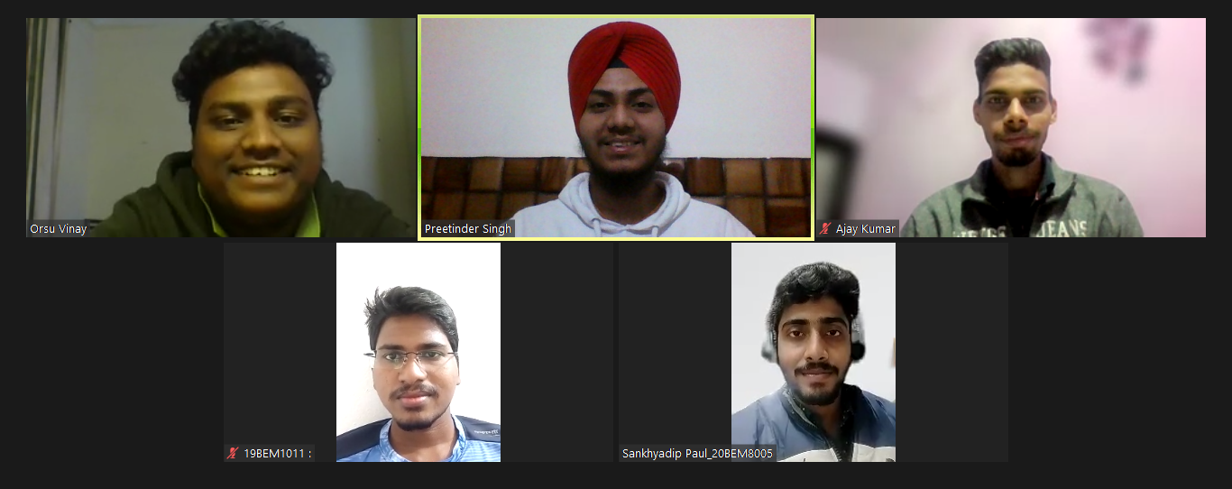
Virtual Discussions

Slide 12
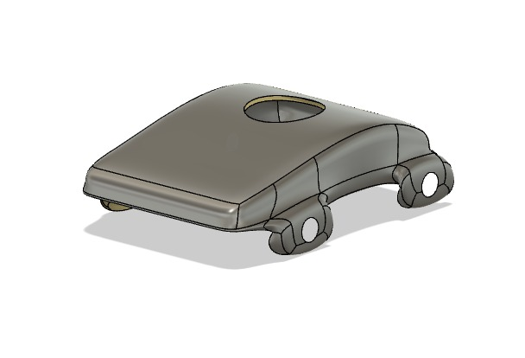
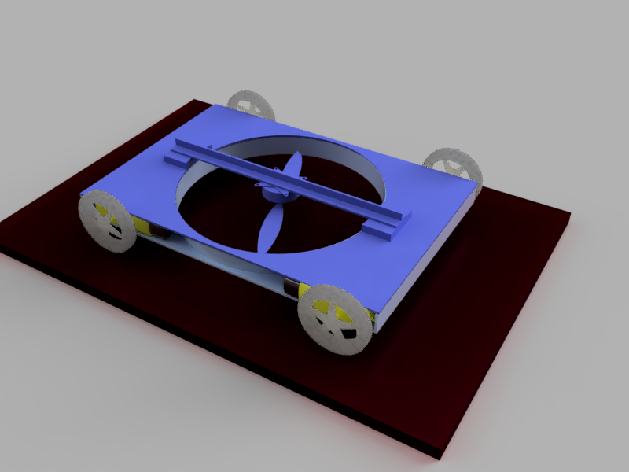
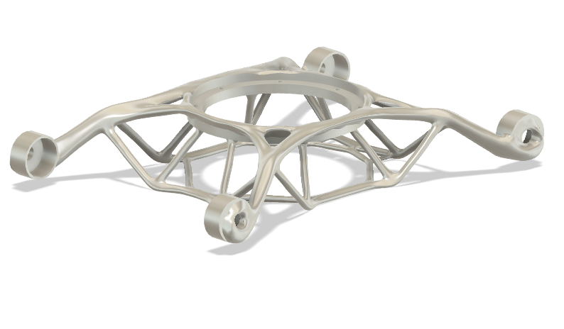
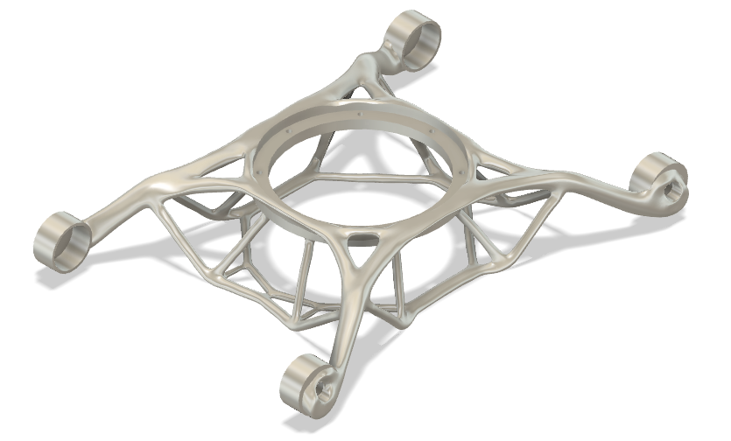
Modification on the design and work progress:

Slide 13
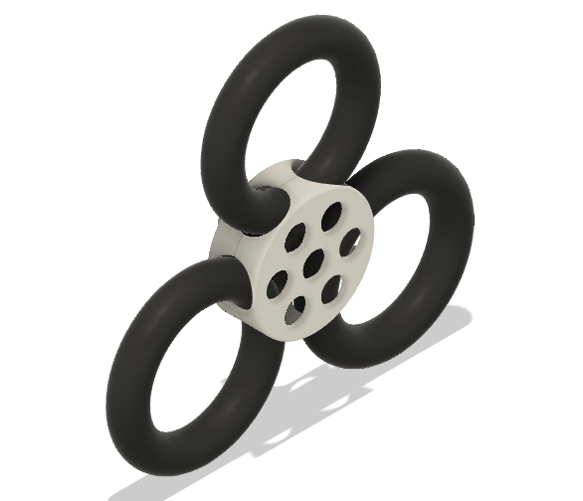
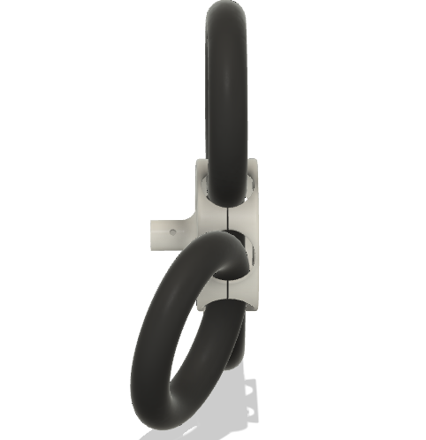
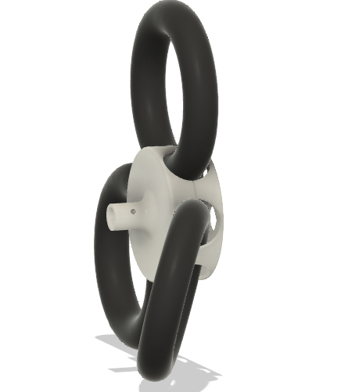
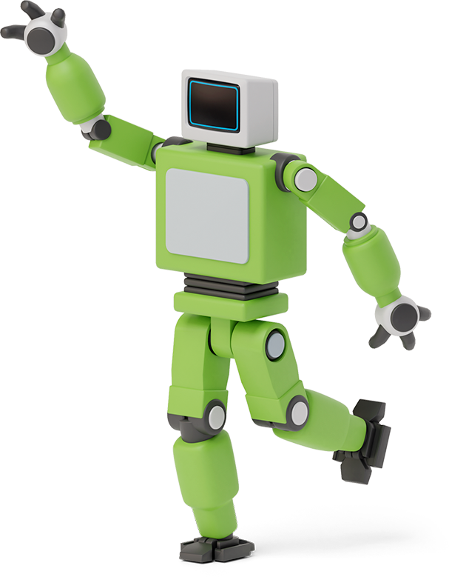
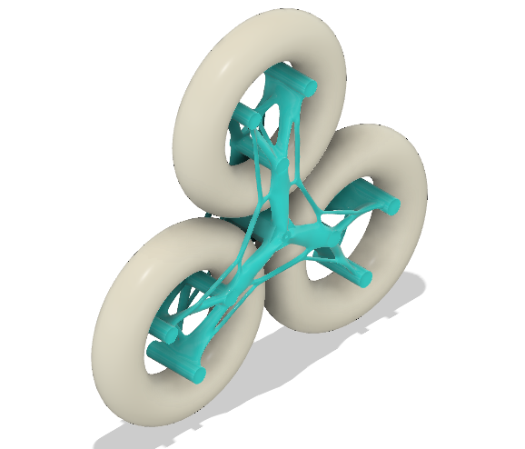
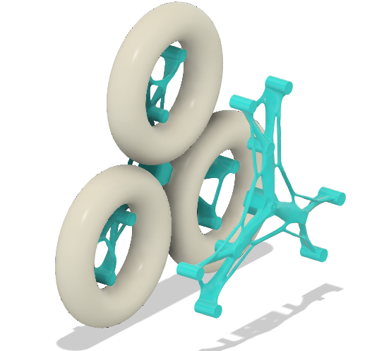

Modification on the design and work progress:

Slide 14
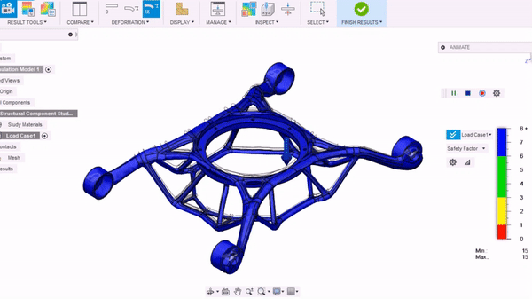
SIMULATION TEST ON Generative designed mAGNESIUM FRAME
Minimum
Factor Of Safety = 288 The body can bear max weight before breaking =288 X 0.88 = 253.44 Kg
Net weight of Additively Manufactured frame= 0.88 Kg = 880 g

Slide 15
Work Distribution
Preetinder Singh
*Idea generation
* Design & Build
*Feature enhancement
*Physical assembly
* PPT formation
* Research Paper
Orsu Vinay
*Idea generation
* Design & Build
*Feature enhancement
*Physical assembly
* PPT formation
* Research Paper
Pacha Bhanuprasad
*Idea generation
* Design & Build
*Feature enhancement
* Project Report
* Project Synopsis
*PPT modification
Ajay Kumar
*Idea generation
* Design & Build
*Feature enhancement
* Project Report
* Project Synopsis
* PPT modification
Sankhyadip paul
*Idea generation
* Design & Build
*Feature enhancement
* Physical assembly
* PPT modification
* Research Paper

Slide 16
Applications based on innovative concept of our Robot
Archaeology
Space exploration
Mining industry
Wall crack detection and repair
Window cleaning and Wall painting of multistory buildings without risk to human lives
Underwater research
Spying and military applications

Slide 17
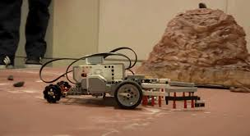
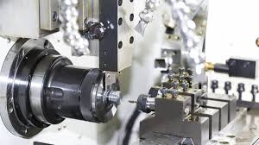
Future scope:
We are achieved some of the objectives in the current semester with the RF control and we have completed design and selection of materials research now we are planning for the applying the some of the machine learning algorithms and some leading techniques like of image processing, obstacle avoidance, and self sensing in the project to make our project advance as we mentioned it’s design and research based project so with that flow we want to conclude we are not ending the project in this semester.

Slide 18
FUTURE SPACER VERSIONS
VERSION 0: CLIMBING , WATER PROOF , UNDER WATER , OVER WATER.
VERSION 1.0: ROBOT CAN CLIMB MOUNTAINS WITH THE HELP OF SOFT ROBOTICS.
VERSION 2.0: AUTONOMOUS BEHAVIOR IN THE ROBOT WITH GUIDING OTHER SWARM ROBOTS.
VERSION 3.0: SLAVES AS DRONES AND MASTER TO GUIDE THE DRONES TO GIVE THEM INSTRUCTIONS.

Slide 19
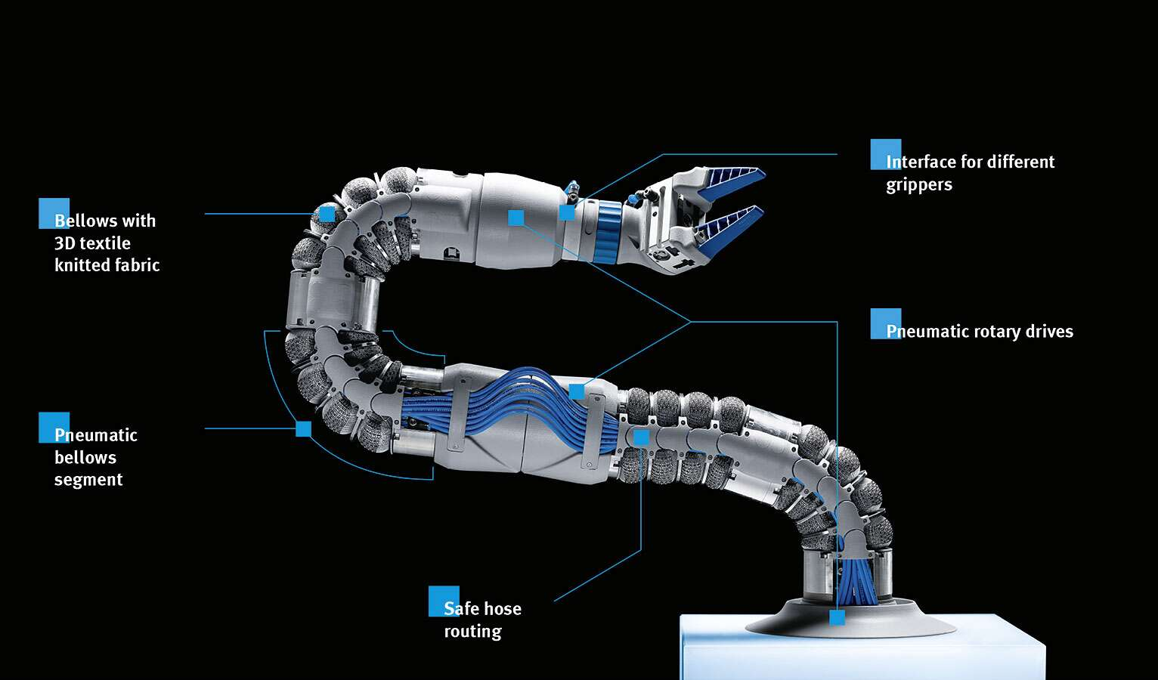
Concepts which we will be incorporating
Soft Robotics based ARM: Soft robotics is the specific sub-field of robotics dealing with constructing robots from highly compliant materials, similar to those found in living organisms. Soft robotics draws heavily from the way in which living organisms move and adapt to their surroundings.

Slide 20
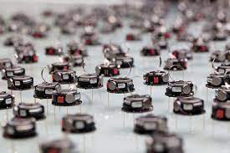
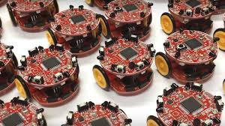
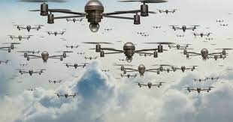
Concepts which we will be incorporating
Swarm Robotics: It is an approach to the coordination of multiple robots as a system which consist of large numbers of mostly simple physical robots. It is supposed that a desired collective behavior emerges from the interactions between the robots and interactions of robots with the environment.

Slide 21
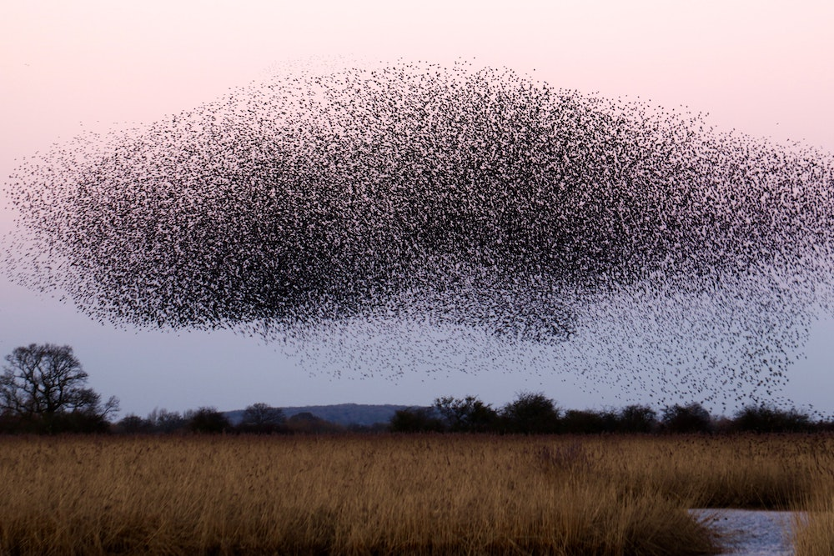
Emergent behaviour

Slide 22

Terrains which we expect our
robots to be used upon

Slide 23
Conclusion..
Our team has worked hard in creating such innovative concept which is very helpful in upcoming needs of future. Each member of our team played a vital role and became equally important for bringing this project to its current state of value.
We all have seriously envisioned this project and we want to accomplish it to its final stages but because of complexity involved and lack of resources in this
COVID pandemic, we have tried our best to achieve some of the main important objectives and bring it to its present state.
So at the end we would like to conclude that all of us enjoyed a lot making this project and simultaneously we learned about enormous new things in various respective fields which were in coherence with our project. We believe that we have accomplished a lot in this short span of time but still we see that there is huge possibility of improvement which we would like to accomplish in our upcoming semester with more enthusiasm and enhancing the features of our present robot.

Slide 24

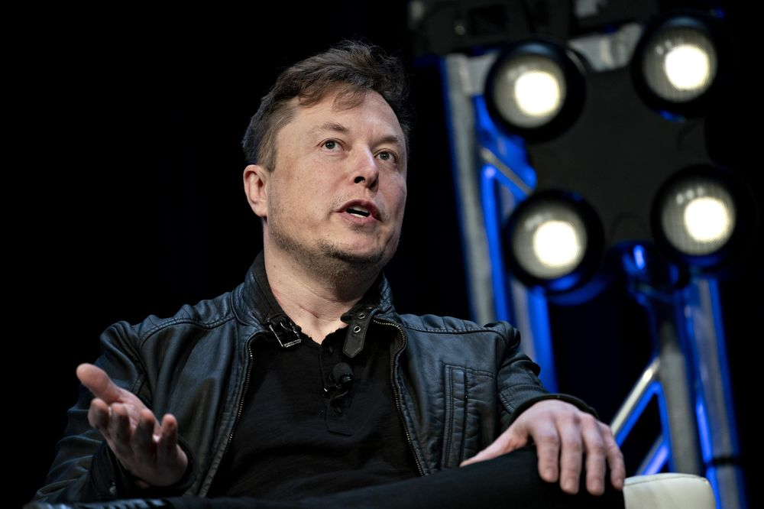
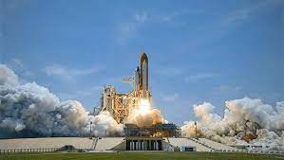
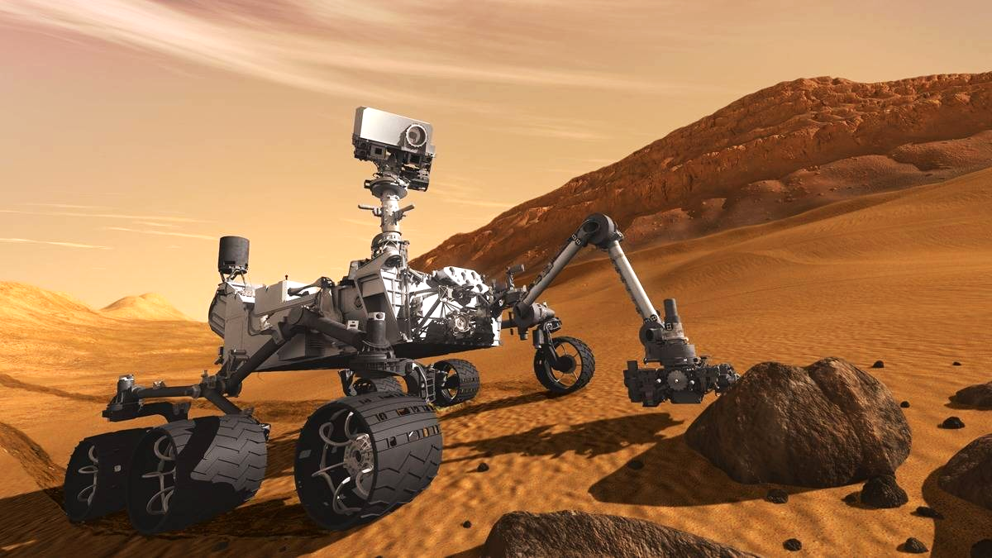
Inspire !
“MAN OF DIFFERENT ATTEMPTS WHO CARE OF DIFFERENT IDEAS…. WE HOPE OUR IDEAS REACH U…”

Slide 25

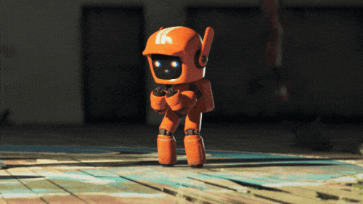
Thanks!
Thanks a lot

